Slide 1
Module XI
The activations, loss functions, and SGD
of neural networks

Slide 2
Squishing function I: Logistic or sigmoid & tanh
Z can be numbers from your transformed vector
Theta of z gives you non-linearly squished output !
Common activation for final layer with two classes
Can be used in earlier layers, but learn slowly at either ends!
Multiclass extension of sigmoid is softmax
Source: towards data science

Slide 3
Squishing function II: ReLU
ReLU stands for rectified linear unit
Most popular activation function in DNNs
Usually used in hidden layers except the final layer
Great learning for positive values
Does a poor job of mapping negative values
Variations of ReLU have been tried: leaky ReLU
Source: towards data science

Slide 4
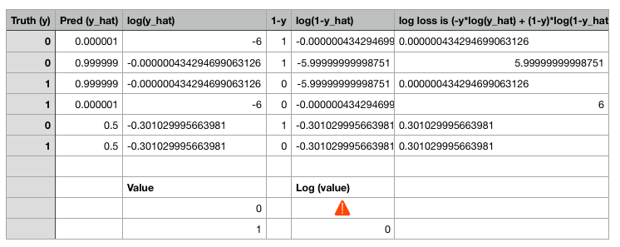
Loss function for DNN: Binary cross entropy
Binary cross entropy
Loss function is for one row
Cost function is average across bunch of rows
In multi-class scenario, binary cross-entropy becomes
categorical cross-entropy
Case (1) Y = 0
Case (2) Y = 1
Source: towards data science

Slide 5
Cost function landscape for SGD
DNN cost function landscape has several saddle points
Source: andrewng ml course, Rosie Campbell on Medium

